Slide 1
International Cooperation of BRICS Countries
Higher Education, research and capacity building
Profa. Andréa Santos, D.Sc.
Transportation Engineering Program
COPPE - Federal University of Rio de Janeiro

Slide 2


The Transportation Engineering Program
Research Lines
• Cities and Mobility
• Transport Management and Operation
• Logistics
• Sustainable Transportation.
www.pet.coppe.UFRJ.br
https://www.pet.coppe.ufrj.br/images/documentos/Relatorio_Pet_Coppe_Final_2022.pdf

Slide 3

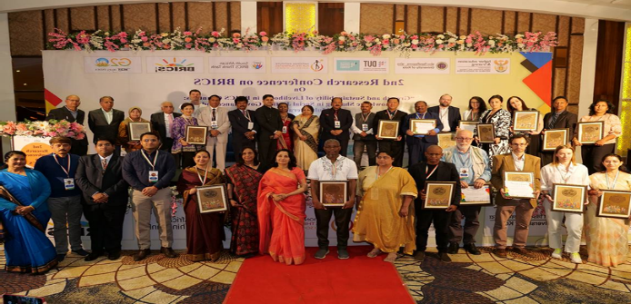
Key Activities/Milestones
Capacity Development Fellows (CDFs)
- BRICS Postgraduate Forum(s)
- BRICS Summer School
- Writing Retreats
Communities of Practice (CoPs)
- BRICS Research Conference(s)
Dialogues
Workshops
Journal Articles/Book Chapters
Journal Special Issues
Co-Edited Books

Slide 4
Background
The BRICS research project at DUT (now DUT-BRICS-Research Institute) is an NIHSS funded initiative aimed at "exploring political and economic governance and achieving progress through sharing knowledge and innovation" within the BRICS Nations.
The National Institute for the Humanities and Social Sciences (NIHSS) granted funding to researchers from the BRICS nations for the BRICS project 1.0 and BRICS project 2.0.
BRICS Research Project 1.0
started on 01 November 2021 and ended on 31 October 2022.
BRICS Research Project 2.0
started on 01 November 2022 and anticipated to end on 31 October 2024.

Slide 5
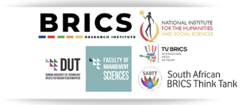
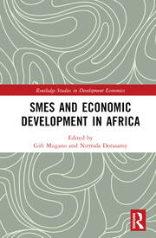
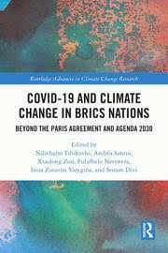
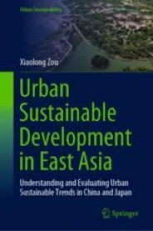
Published books in 2023
“SMEs and Economic Development in Africa”- Book editors: Prof Gift Mugano and Prof Nirmala Dorosamy
“COVID-19 and Climate Change in BRICS Nations” Beyond the Paris Agreement and Agenda 2030. Book editors: Dr Ndivhuho Tshikovhi, Dr Andrea Santos, Prof Xiaolong Zou, Prof Fulufhelo Netswera, Prof Irina Zotovna Yarygina and Dr Sriram Divi
“Urban Sustainable Development in East Asia Understanding and Evaluating Urban Sustainable Trends in China and Japan” book editor: Xiaolong Zou

Slide 6
